Slide 1
Cold War
Day 1

Slide 2
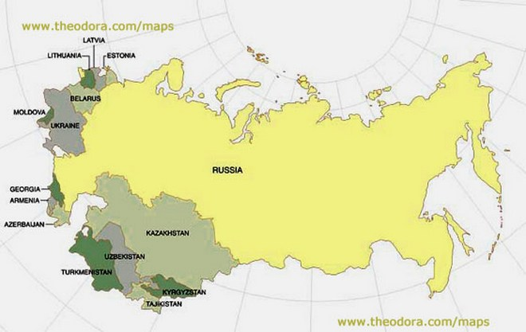
The Soviet Union

Slide 3
Cold War
Political hostility between two countries without open warfare, usually referring to the hostility between the United States and Soviet Union after WWII
To prove whether Communism or Capitalism was the best form of economy
Both countries frantically try to find countries to join them

Slide 4
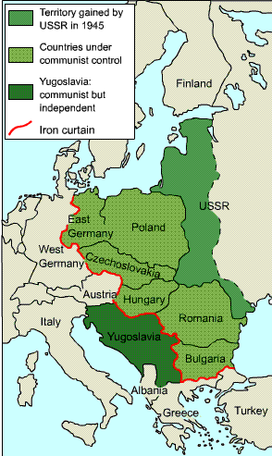
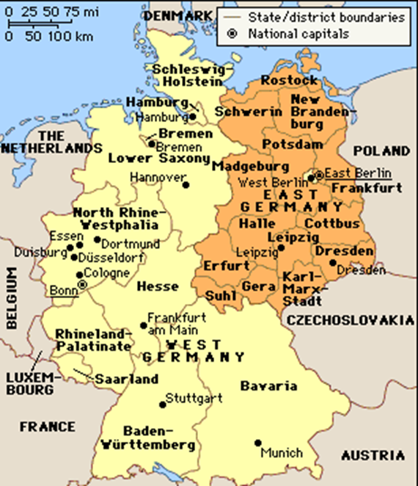
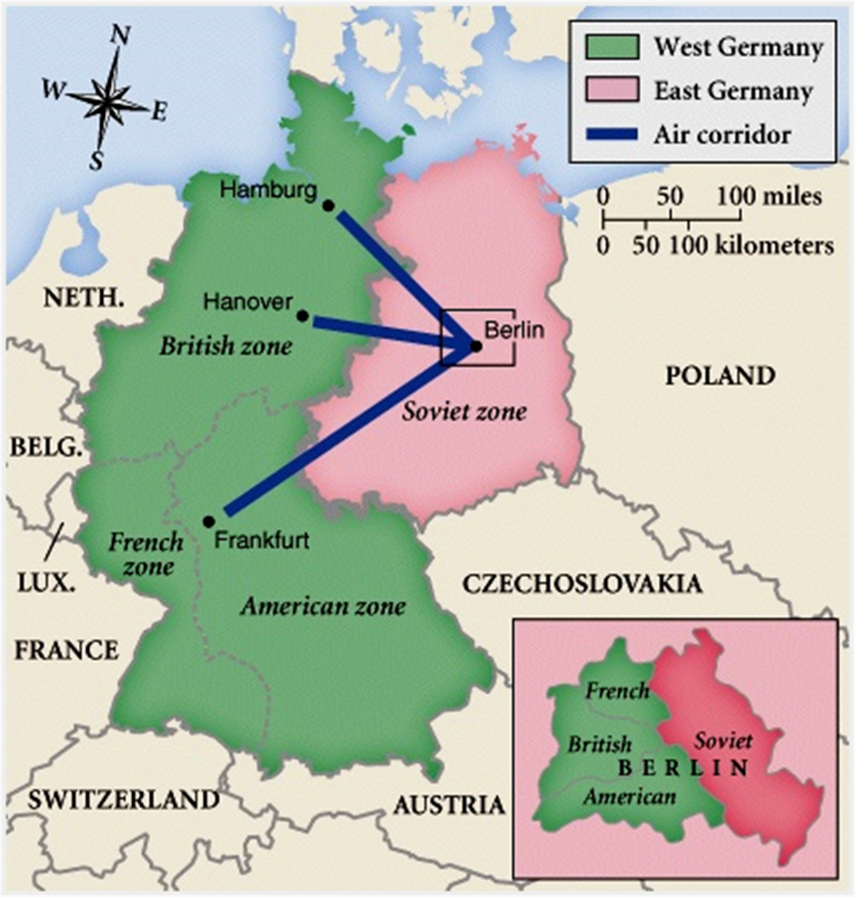
Germany after WWII
Germany was divided in two
West ruled by Capitalism
East ruled by the Soviets and Communism
They split the city of Berlin in half
Soviets created a wall to keep west Berlin out of contact with their east Berlin
http://www.history.com/topics/cold-war/berlin-airlift

Slide 5
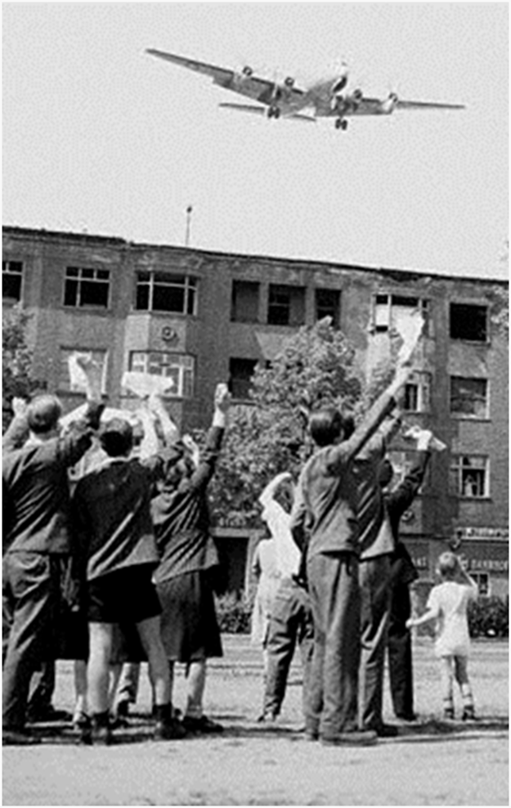
Berlin Blockade
Berlin was within Soviet territory
In order for Allies to get supplies to their section of Berlin, they had to pass Soviet inspections
Soviets blockaded supplies so as to push allies out of Berlin
Berlin airlift
In response, the allies dropped supplies in using airplanes
Candy Bomber
https://www.youtube.com/watch?v=Y4nnmUlzCk8

Slide 6
Domino Effect
United States worried that if one European country fell to communism it would start a domino effect that could spread across the world
The Soviet Union was too powerful over all communistic countries
In order to combat the Domino Effect America began two policies
The Marshall Plan
Truman Doctrine

Slide 7
Truman Doctrine
Wanting to avoid dictators like Hitler and the spread of Communism
President Truman promised to support free people who were resisting Communism

Slide 8
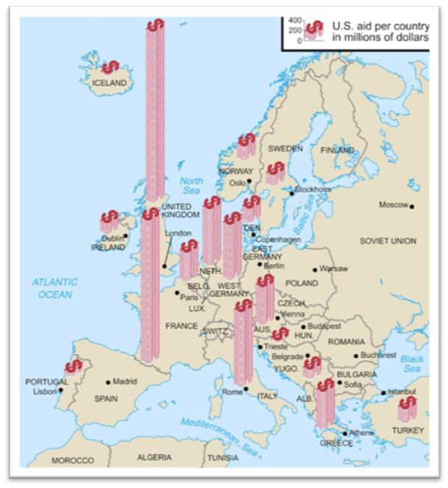
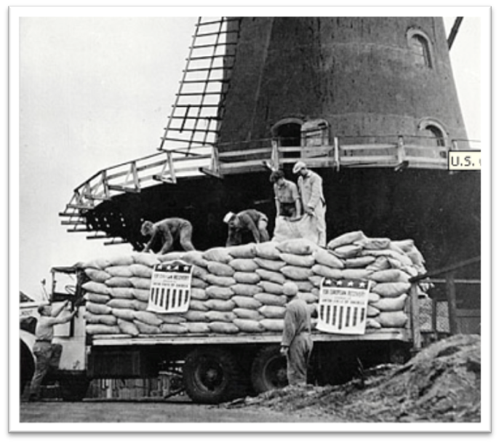
The Marshall Plan
With Europe recovering from WWII, U.S. was afraid it was too weak to withstand Communism
United States funneled money into Europe to rebuild their economy and create prosperity
Meant to reduce the appeal of Communism

Slide 9
Cold War
Day 2

Slide 10
1. “Can He Block It?”

Slide 11
2.

Slide 12
3. “Come On Sam! It’s Up to Us Again!”

Slide 13
4. Soviet Union Political Cartoon
The man in this cartoon is representing General Marshall
The harnesses are labeled “For the French” and “For the Germans”

Slide 14
Cold War
Day 3

Slide 15
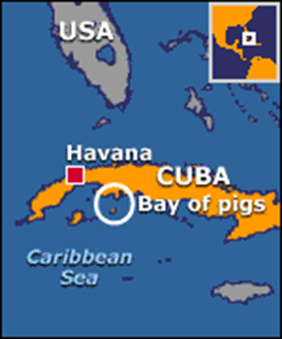
Events of Cold War: Bay of Pigs
CIA transported a force of highly trained Cubans to invade Cuba and overthrow Castro (Communist leader)
Invasion was a complete failure and actually strengthened Castro’s position in Cuba

Slide 16
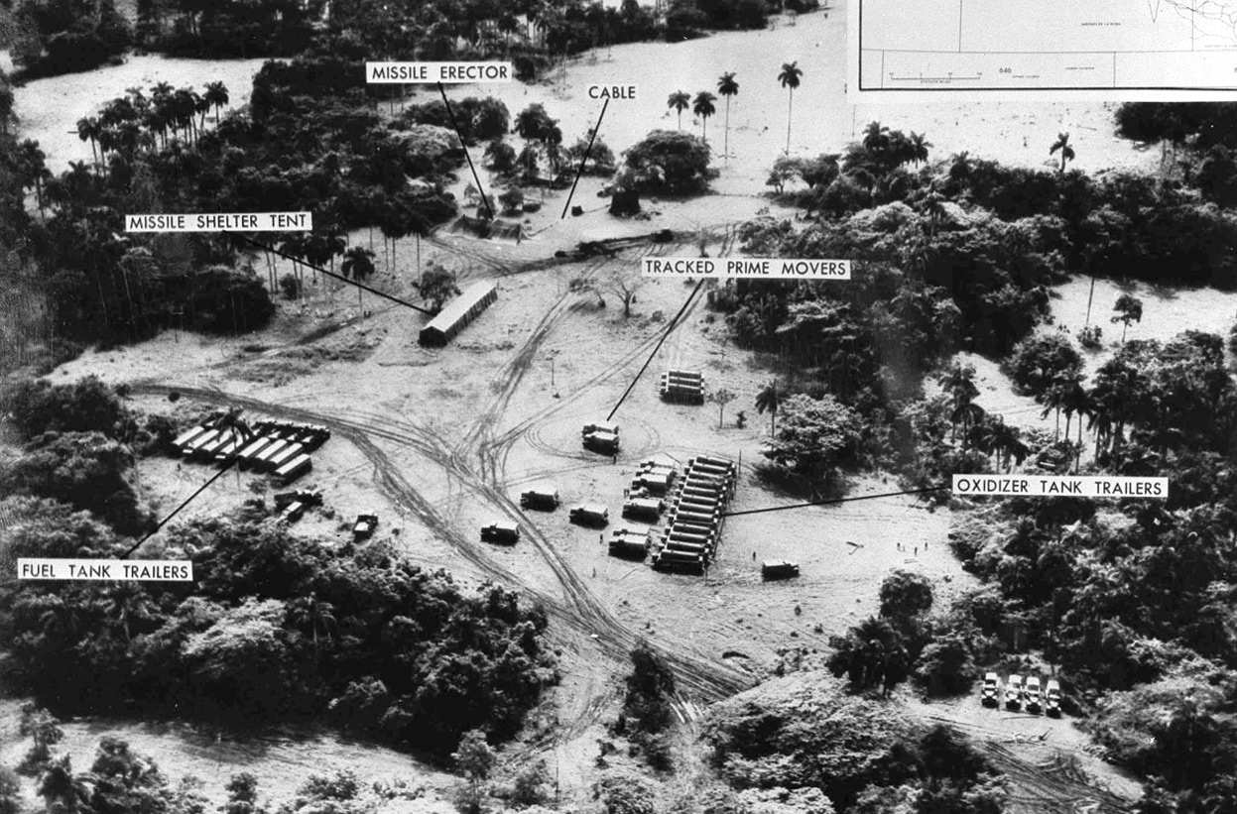
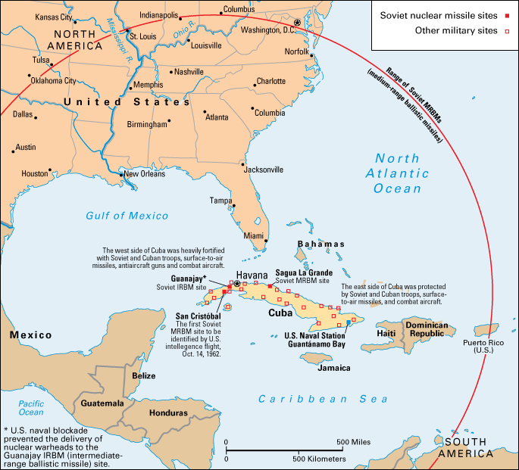
Cuban Missile Crisis

Slide 17
Cold War
Day 4: Butter Battle Book

Slide 18
Nuclear Tension
After U.S. dropped Atomic Bomb on Japan
U.S. and Soviet Union entered a weapons development race
Fear that the other would use nuclear weapons against each other
Both spent tons of money developing weapons to try to best the other
Resulted in a widespread paranoia of Russia and nuclear weapons
This fear was more prominent in the U.S. because Russia censored media
Arms Race: mass buildup of weapons between USSR and United States
Space Race: Who would gain the advantage in space?
Russia sends the first satellite (Sputnik), but US send first person to moon
Russia and U.S. never actually fought a war (Cold War), but both were involved in other wars
Korean Conflict
Vietnam War

Slide 19
Nuclear Tension
“About the capitalist states, it doesn't depend on you whether we (Soviet Union) exist. If you don't like us, don't accept our invitations, and don't invite us to come to see you. Whether you like it our not, history is on our side. We will bury you.”
-- Khrushchev 1956

Slide 20
Duck and Cover: https://www.youtube.com/watch?v=IKqXu-5jw60
Butter Battle Book: https://www.youtube.com/watch?v=C5FR_cuQsrc

Slide 21
Cold War
Day 5: End Cold War

Slide 22
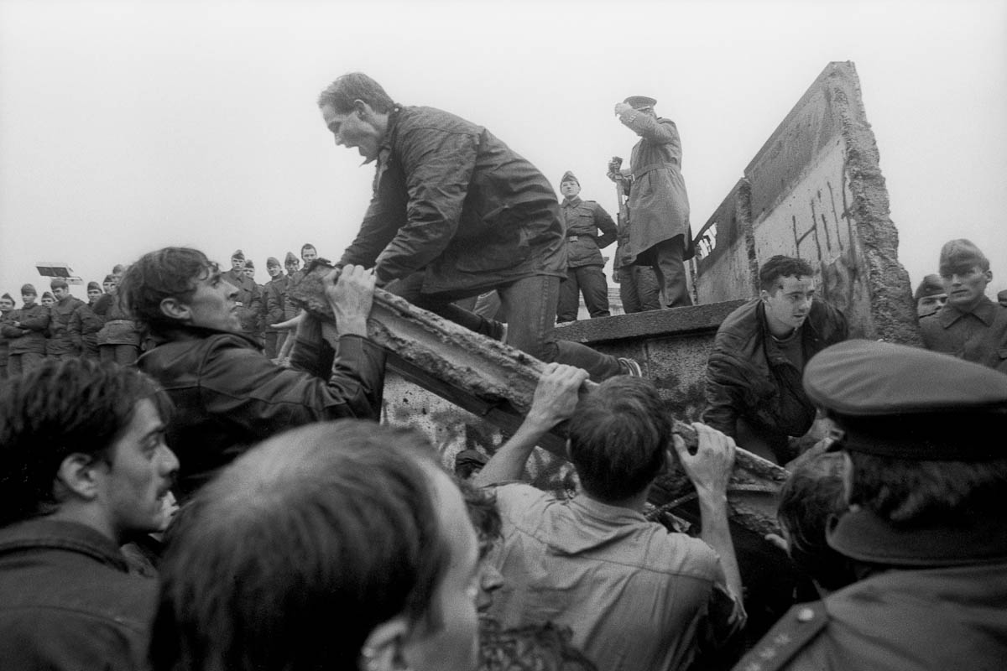
Gorbachev
Soviet Union couldn’t keep up with American industry
Communism made their economy weak
Outmoded products, antiquated industrial plants, obsolete technologies
To incentive for the people to perform at higher levels
Gorbachev tried to reform their economy by decentralizing their economy and admitting past mistakes
But this slight shift away from Communism was too late
Soviet Union was plagued with
Poor education, corruption, alcoholism, economic failure
The Berlin Wall came down and Eastern European countries slowly gained independence

