Slide 1
Civil War Begins
Secession: the act of formally withdrawing from the Union

Slide 2
Election of 1860
Democratic Party split between Northern and Southern members
A new political party known as Republicans nominated Abraham Lincoln
His political platform revolved around ending the spread of slavery
The country split votes between four candidates
Abraham Lincoln won with less than 40% of the popular vote
Notes:
Many Southern states didn’t even put Lincoln on their ballot

Slide 3
Secession
Southerners believed Lincoln would abolish slavery
Days after the election, South Carolina’s legislature voted to secede
In Southerners eyes, each original state voluntarily joined the union which means they could voluntarily leave the union at any time
Mississippi, Florida, Alabama, Georgia, Louisiana and Texas quickly followed
They met an established a new nation called the Confederate States of America
Jefferson Davis was elected as their President

Slide 4
Civil War Begins
United States troops stationed in South Caroline retreated to Fort Sumter after S. Carolina seceded
Confederate States order the U.S. troops to leave the fort and they refused
They attacked Fort Sumter on the morning of April 12, 1861

Slide 5
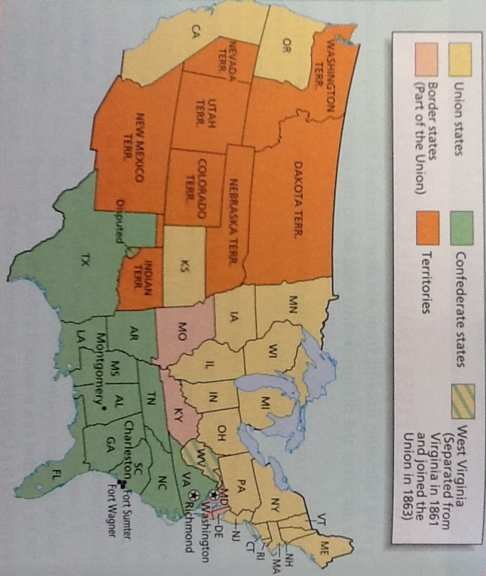
Choosing Sides
http://www.amazon.com/The-Civil-War-Film-Burns/dp/B004AZCWKC
http://www.pbs.org/civilwar/classroom/episode1.html

