Slide 1
US Government
Checks and Balances

Slide 2
EXECUTIVE BRANCH
Checks on Legislature
Checks on Judicial
Veto Laws
Call Special Sessions of Congress
Appoints Federal Judges
Grant Pardons to Federal Offenders

Slide 3
LEGISLATIVE BRANCH
Checks on Executive
Checks on Judicial
Ratifies Treaties
Determines use of Money
Override President’s Veto
Impeach President
Impeach or remove judges
Approves appointments of judges
Propose amendments to overrule judicial decisions
Notes:
Override veto with 2/3 majority vote
Why does Legislative branch have so many more checks than the other branches?

Slide 4
JUDICIAL BRANCH
Checks on Executive
Checks on Legislative
Declare Executive Actions Unconstitutional
Declare Acts of Congress Unconstitutional

Slide 5
Federalism
States
Federal
Reserved Powers
Education
Local Governments
Marriage laws
Trade within state
Delegated Powers
Declare War
Armed Forces
Interstate Trade
Post offices
Standard weight and measures
Coin money
Foreign policy
SUPREMACY CLAUSE: All federal laws overrule state laws

Slide 6
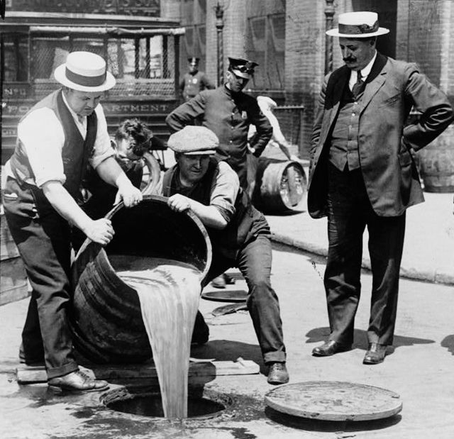
Prohibition
Progressive Era
Temperance Movement
Wartime Prohibition
Volstead Act
Notes:
Couldn’t uphold laws against alcohol because they were unconstitutional. How do you change that? Add an amendment

Slide 7
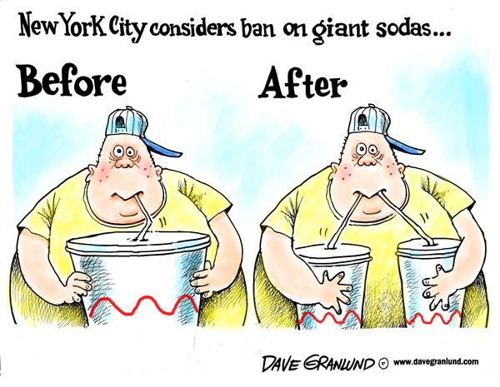
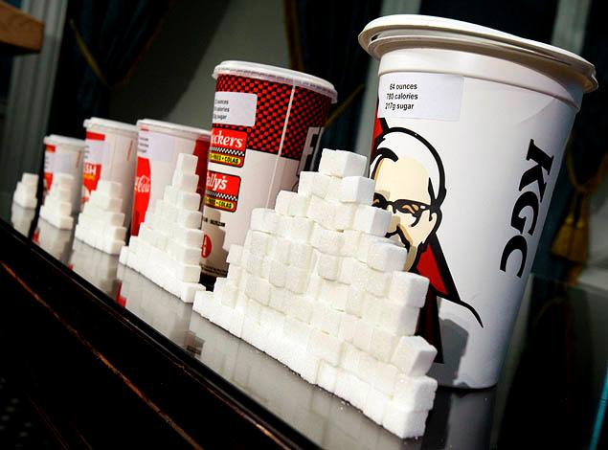
Ban on Soda
Mayor Bloomberg banned the sale of large sugary drinks
SUMMARY QUESTIONS:
What was the law?
Who agreed with the law?
Did the law uphold in the courts?

Slide 8
Gun Rights
Missouri Gun Bill
Passed by Republicans
Stop federal enforcement of gun control laws
Journalists can’t publish names of gun owners
SUMMARY QUESTION:
What did the bill do?
Did the bill pass? The legislature? The executive branch?

Slide 9
Prohibition Newspaper

