Slide 1
Buddhism

Slide 2
Four Noble Truths
The goal of these truths is to reduce suffering:
Everything and Everyone Suffers
Suffering is caused by selfishness, greed and desire
Selfishness greed and desire can be stopped
The way desire and selfishness can be stopped is by following the eight fold path

Slide 3
Eight Fold Path
Right Belief: Believe what is true
Right Purpose: Live in a loving, non-violent way
Right Speech: Speak well to others
Right Actions: Treat yourself well but to no indulge
Rights Livelihood: Choose a good job
Right Effort: Be positive, avoid negativity
Right Thought: Think clearly
Right Concentration: Meditate on the meaning of life

Slide 4
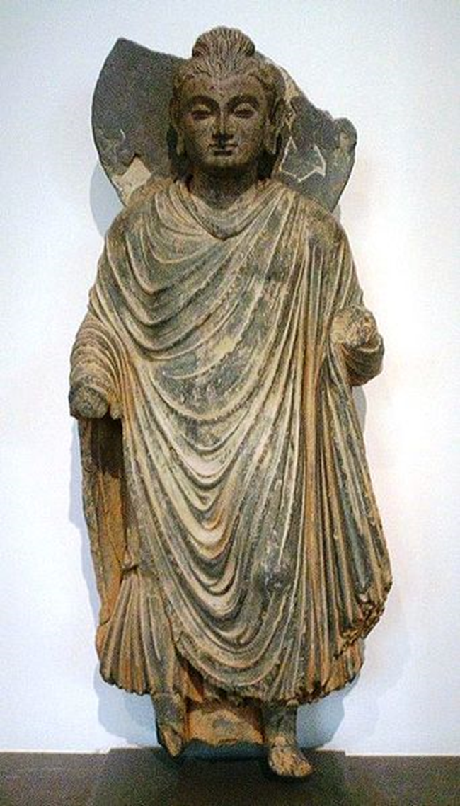
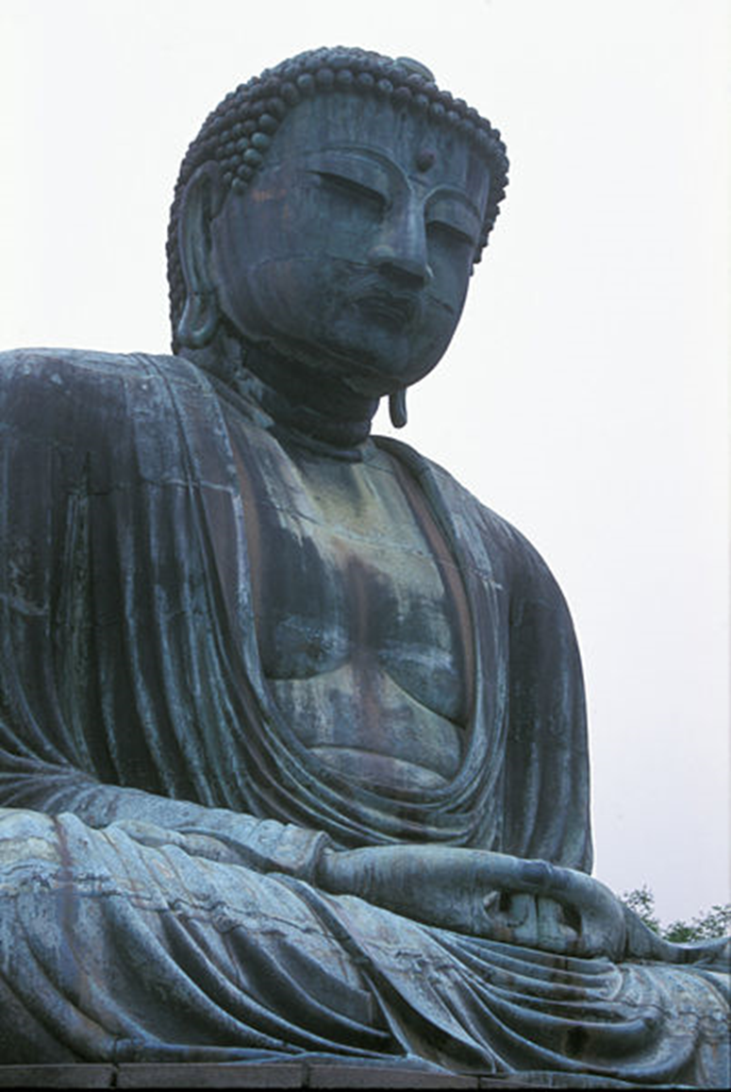
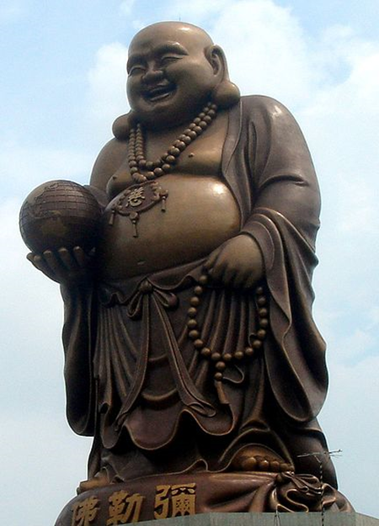
Buddha
Buddha is not a name but a title meaning “Enlightened One”
Siddhartha Gautama was the name of the first Buddha

Slide 5
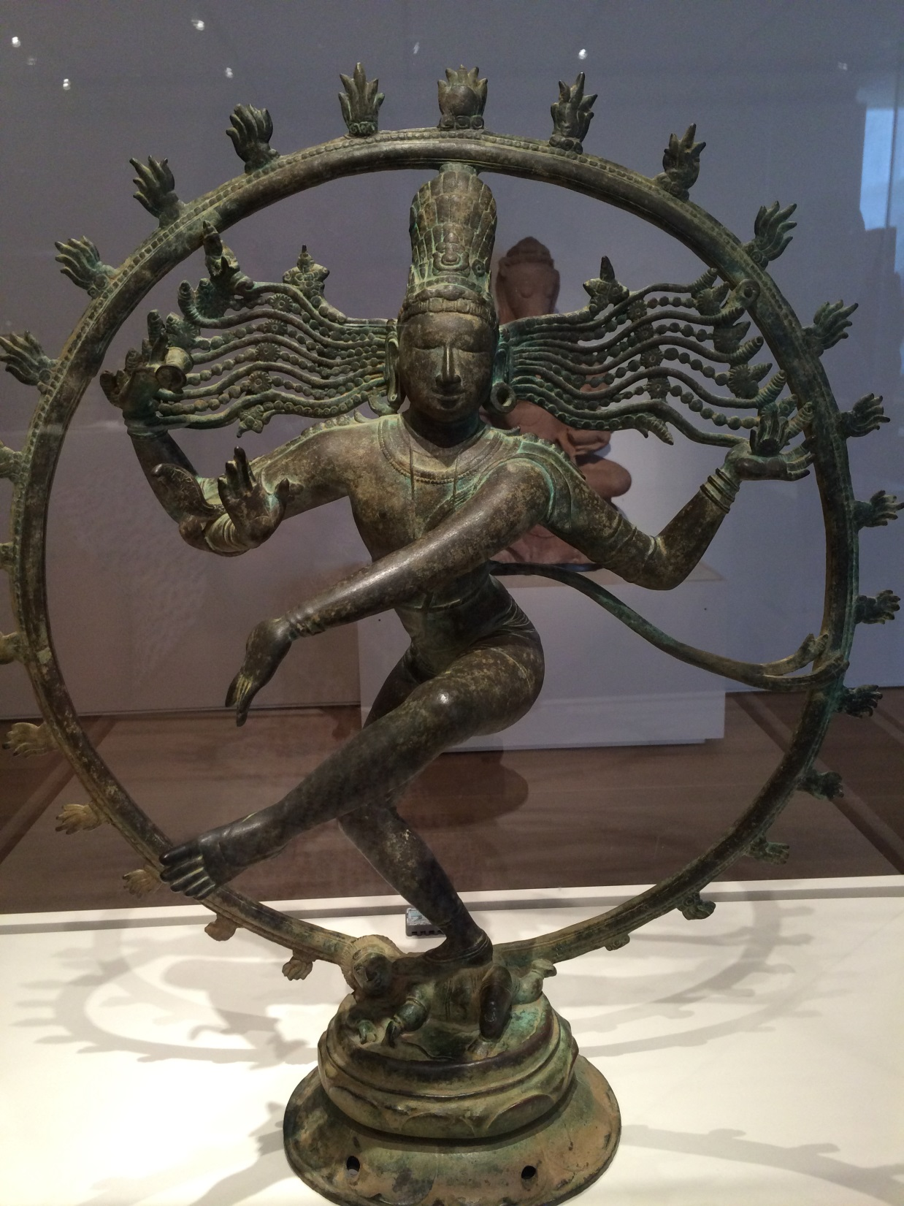
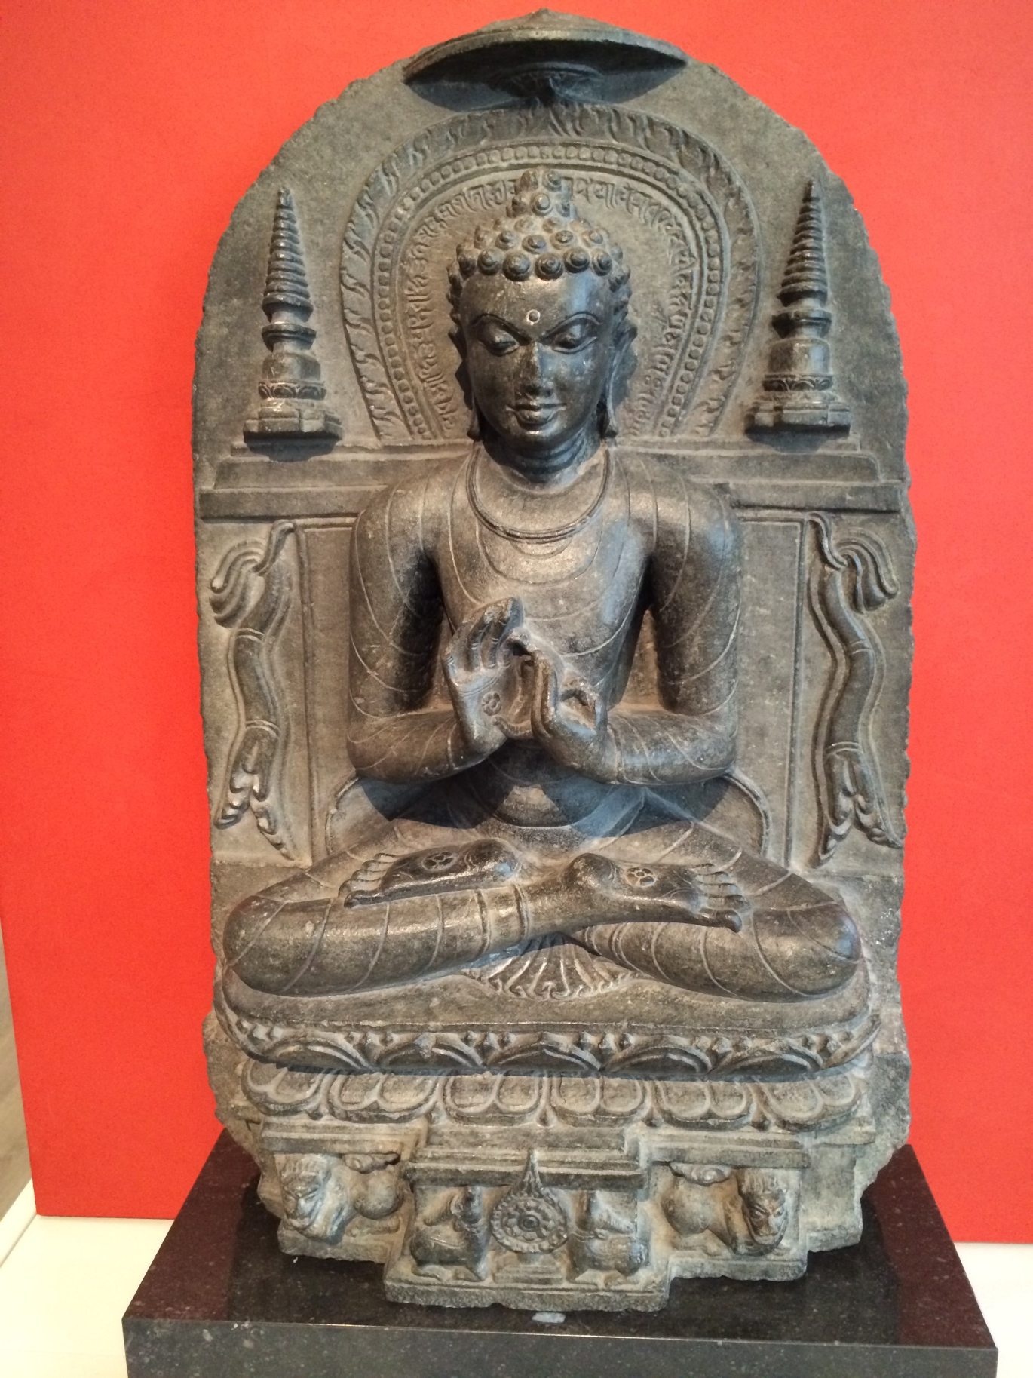
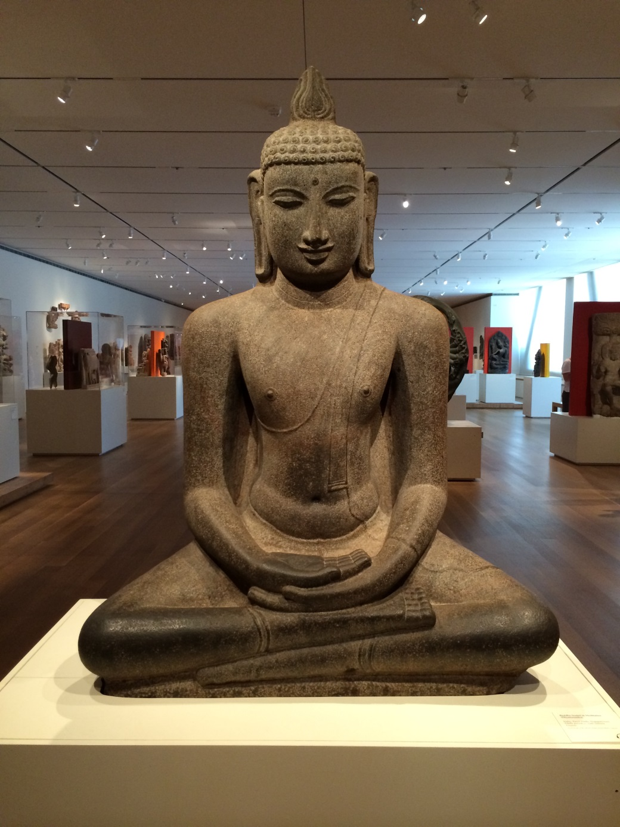
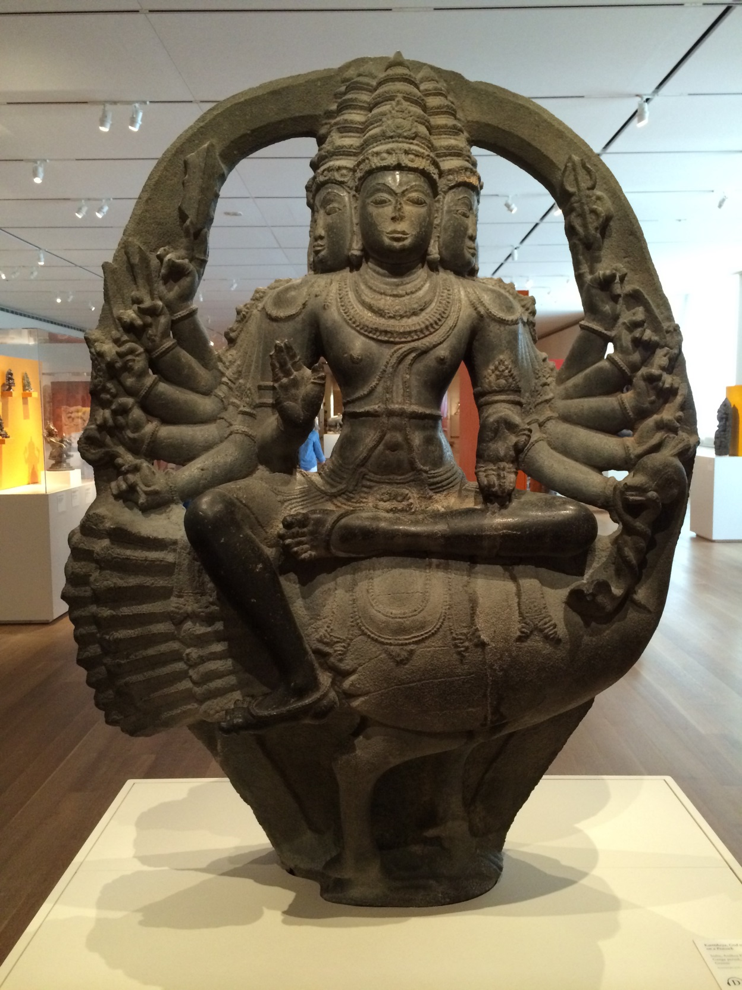
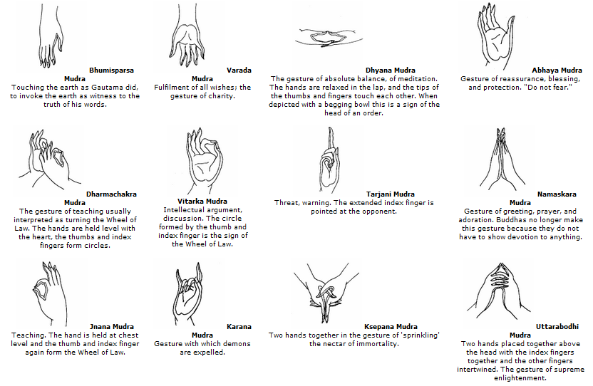
Mudras
Hand Positions of Buddha

Slide 6
The Middle Way
Buddhists try to follow the middle way.
This means living a life of moderation, not being to extreme in things. Especially worldly things.

Slide 7
Karma
If you do good things good will come back to you
If you do bad things bad will come back to you
Everything you do plants a seed either good or bad, the fruits of those seeds will come back to you in this life or the next

Slide 8
Rebirth
One’s state of consciousness is reborn after death.
The state of your rebirth depends on karma from the last life.
If you lived a good life then you might be reborn wealthy. If you lived a bad life you might be reborn a slave.

Slide 9
Nirvana
State of spiritual perfection and enlightenment
Quiet contemplation, thoughtful reflection, disciplined self-control
Once Nirvana is met they escape the cycle of incarnation

Slide 10
Meditation Session
https://www.youtube.com/watch?v=wbhQrDoRNVo

