Slide 1
Boston Massacre

Slide 2
Massacre:
an indiscriminate and brutal slaughter of people
To deliberately and violently kill a large number of people

Slide 3
The Lead Up
Parliamnet passed the Townshend Acts, which placed duties on imported glass, lead, paint, paper, and tea.
Used to pay debt AND salary of colonial governors to keep them loyal to the crown
To enforce the Townshend Acts, Britain used Writs of Assitance.
Allowed tax collectors to search for smuggled goods.

Slide 4
Boston Massacre
Tax collectors in Massachusetts seized the ship Liberty on suspicion of smuggling
Colonists rebel and British troops were sent into Boston.
Many Bostonians believed that the British government had sent the troops to silence its critics.

Slide 5
Boston Massacre
Samuel Adams declared, “I look upon [British soldiers] as foreign enemies.”
Both sides disliked each other
Name calling and fist fights were common.

Slide 6
Boston Massacre
The tension exploded on March 5, 1770 when a lone British soldier standing guard got into a fight with a colonist.
A crowd of colonists gathered around the soldier, throwing snowballs and shouting insults
A small group of British troops arrived
Notes:
BRITISH PERSPECTIVE: Snowballs had ice, Americans were daring them to shoot, one American hit a soldier with a club which caused the soldier to move aside and shoot, then someone yelled fire and British shot, but it could have been the colonists egging them on, they called it the “Incident on King’s Street”

Slide 7
Boston Massacre
The crowd grew louder and angrier by the moment
Suddenly, the soldiers fired into the crowd killing five colonists
http://www.history.com/topics/american-revolution/boston-massacre/videos/boston-massacre
Is this a massacre?
Notes:
Picture hyperlinked to 3 min clip on it. Good video and explanation.

Slide 8
Propaganda
Samuel Adams and many others immediately began using the Boston Massacre as a form of Propaganda
Stories or images aimed at influencing the attitude of a community by presenting only one side of an argument

Slide 9
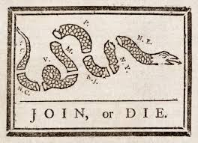
Propaganda
Can you think of things have we talked about throughout this unit already that could qualify as propaganda?
“No taxation without representation”
Stamp Act readings
“It is your duty to fight this tax. . . . [deliver] us from the enemies of truth and liberty” – Boston Gazette
“I am daily threatened by verbal messages and anonymous letters with a mob of several thousand people” –John Hughes
Albany Plan of Union

Slide 10
Boston Massacre-British account
The British point of view: Excerpt from the report of Captain Thomas Preston:
...In my way there I saw the people in great commotion, and heard them use the most cruel and horrid threats against the troops. In a few minutes after I reached the guard, about 100 people passed it and went towards the custom house where the king's money is lodged. They immediately surrounded the sentry posted there, and with clubs and other weapons threatened to execute their vengeance on him. I was soon informed by a townsman their intention was to carry off the soldier from his post and probably murder him... I immediately sent a noncommissioned officer and 12 men to protect both the sentry and the king's money, and very soon followed myself to prevent, if possible, all disorder, fearing lest the officer and soldiers, by the insults and provocations of the rioters, should be thrown off their guard and commit some rash act. They soon rushed through the people, and by charging their bayonets in half-circles, kept them at a little distance. ..The mob still increased and were more outrageous, striking their clubs or bludgeons one against another, and calling out, come on you rascals, you bloody backs, you lobster scoundrels, fire if you dare, G-d d--n you, fire and be d--ned, we know you dare not, and much more such language was used.

Slide 11
British continued
At this time I was between the soldiers and the mob, parleying with, and endeavouring all in my power to persuade them to retire peaceably, but to no purpose. They advanced to the points of the bayonets, struck some of them and even the muzzles of the pieces, and seemed to be endeavouring to close with the soldiers. On which some well behaved persons asked me if the guns were charged. I replied yes. They then asked me if I intended to order the men to fire. I answered no, by no means, observing to them that I was advanced before the muzzles of the men's pieces, and must fall a sacrifice if they fired ...While I was thus speaking, one of the soldiers having received a severe blow with a stick, stepped a little on one side and instantly fired, on which turning to and asking him why he fired without orders, I was struck with a club on my arm, which for some time deprived me of the use of it, which blow had it been placed on my head, most probably would have destroyed me. On this a general attack was made on the men by a great number of heavy clubs and snowballs being thrown at them, by which all our lives were in imminent danger, some persons at the same time from behind calling out, d--n your bloods- why don't you fire. Instantly three or four of the soldiers fired, one after another, and directly after three more in the same confusion and hurry. The mob then ran away, except three unhappy men who instantly expired, in which number was Mr. Gray at whose rope-walk the prior quarrels took place; one more is since dead, three others are dangerously, and four slightly wounded. The whole of this melancholy affair was transacted in almost 20 minutes. On my asking the soldiers why they fired without orders, they said they heard the word fire and supposed it came from me. This might be the case as many of the mob called out fire, fire, but I assured the men that I gave no such order; that my words were, don't fire, stop your firing. In short, it was scarcely possible for the soldiers to know who said fire, or don't fire, or stop your firing.

Slide 12
American account
The American Point of View: From an anonymous source:
THE HORRID MASSACRE IN BOSTON, PERPETRATED IN THE EVENING OF THE FIFTH DAY OF MARCH, 1770, BY SOLDIERS OF THE TWENTY-NINTH REGIMENT WHICH WITH THE FOURTEENTH REGIMENT WERE THEN QUARTERED THERE; WITH SOME OBSERVATIONS ON THE STATE OF THINGS PRIOR TO THAT CATASTROPHE
...Whether the boys mistook the sentry for one of the said party (a group of unruly soldiers who had been about the area earlier), and thence took occasion to differ with him, or whether he first affronted them, which is affirmed in several depositions,-however that may be, there was much foul language between them, and some of them, in consequence of his pushing at them with his bayonet, threw snowballs at him, which occasioned him to knock hastily at the door of the Custom House. From hence two persons thereupon proceeded immediately to the main-guard, which was posted opposite to the State House, at a small distance, near the head of the said street. The officer on guard was Capt. Preston, who with seven or eight soldiers, with firearms and charged bayonets, issued from the guardhouse, and in great haste posted himself and his soldiers in front of the Custom House, near the corner aforesaid. In passing to this station the soldiers pushed several persons with their bayonets, driving through the people in so rough a manner that it appeared they intended to create a disturbance.

Slide 13
American continued
This occasioned some snowballs to be thrown at them which seems to have been the only provocation that was given. Mr. Knox (between whom and Capt. Preston there was some conversation on the spot) declares, that while he was talking with Capt. Preston, the soldiers of his detachment had attacked the people with their bayonets and that there was not the least provocation given to Capt. Preston of his party; the backs of the people being toward them when the people were attacked.
He also declares, that Capt. Preston seemed to be in great haste and much agitated, and that, according to his opinion, there were not then present in King street above seventy or eighty persons at the extent. The said party (British soldiers) was formed into a half circle; and within a short time after they had been posted at the Custom House, began to fire upon the people. Captain Preston is said to have ordered them to fire, and to have repeated that order. One gun was fired first; then others in succession and with deliberation, till ten or a dozen guns were fired; or till that number of discharges were made from the guns that were fired. By which means eleven persons were killed and wounded, as above represented.

Slide 14
Paul Revere's engraving of the Boston Massacre
Notes:
Ask the students to describe what they see. Are the soldiers organized? Do they appear to be shooting intentionally? Are the colonists armed or provoking the soldiers?
Why does Paul Revere choose to portray the situation in this way? Paul Revere is creating a piece of propaganda to galvanize colonial opposition to Great Britain.

Slide 15
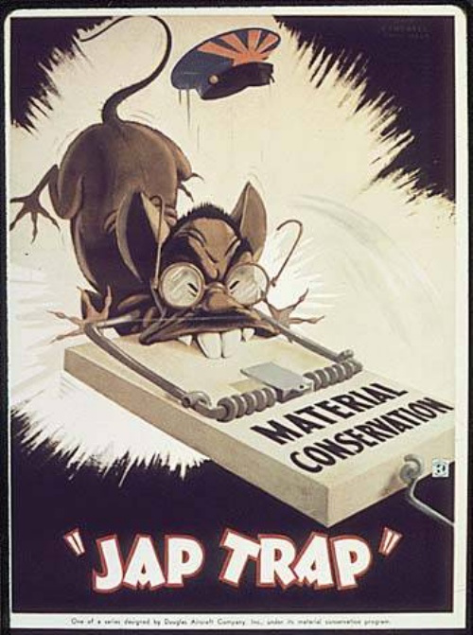
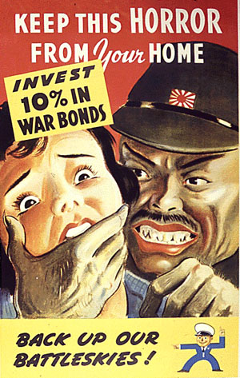

Slide 16
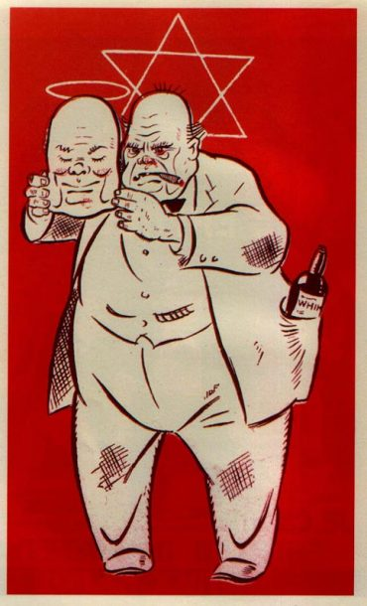

Slide 17
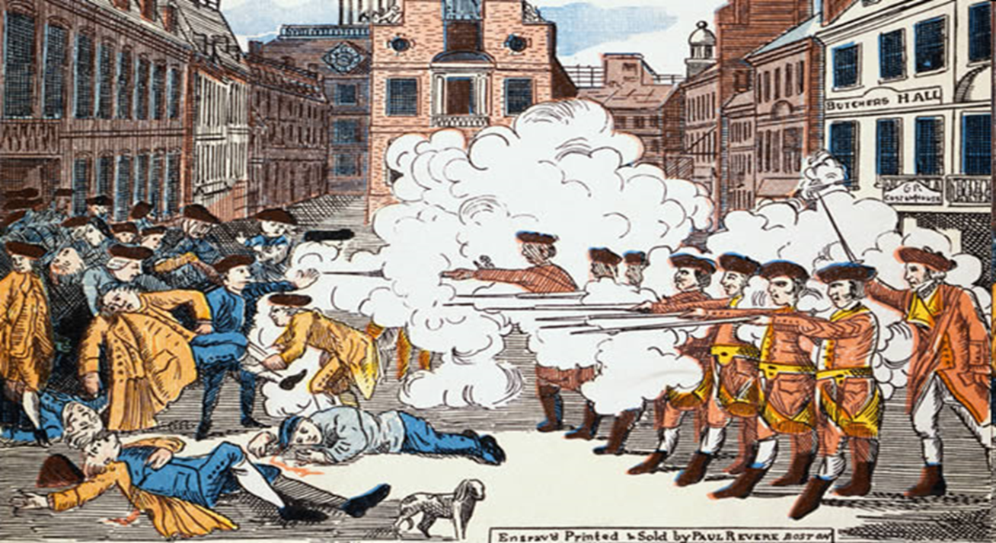
Differing Perspectives
British called the Boston Massacre “The Incident on King Street”
Why does Paul Revere choose to portray the Boston Massacre in this way?

Slide 18
Do events like the Boston Massacre still happen today?

Slide 19
Kent State Lead Up

Slide 20
Kent State Massacre

Slide 21
Ohio
Tin soldiers and Nixon coming, We're finally on our own. This summer I hear the drumming, Four dead in Ohio. Gotta get down to it Soldiers are cutting us down Should have been done long ago. What if you knew her And found her dead on the ground How can you run when you know?
Gotta get down to it Soldiers are cutting us down Should have been done long ago. What if you knew her And found her dead on the ground How can you run when you know? Tin soldiers and Nixon coming, We're finally on our own. This summer I hear the drumming, Four dead in Ohio.

Slide 22
The Song Ohio
Who was at fault?
Who was the victim?
Does the song identify one group as the victims?
Why would the authors portray it this way?
Propaganda – stories and images designed to support a particular point of view (gives only one side to the story)
Notes:
Through this discussion the students should appreciate the complexity of the events at Kent State. The soldiers reacted with a disproportionate level of violence, but they were certainly provoked. The students - throwing rocks and tear gas - are hardly innocent.
They should also realize that Crosby, Stills, Nash, and Young wrote their song partially as a piece of propaganda. Ohio serves its purpose as a protest song by unifying the student movement and strengthening its resolve in opposing the Vietnam War and Nixon's administration.

Slide 23
Notes:
Use this for lesson plan!
http://www.associatedcontent.com/article/421088/lesson_plan_comparing_the_boston_massacre.html?cat=9
They should also realize that Crosby, Stills, Nash, and Young wrote their song partially as a piece of propaganda. Ohio serves its purpose as a protest song by unifying the student movement and strengthening its resolve in opposing the Vietnam War and Nixon's administration.

Slide 24
How were the two events similar?
Involved soldiers shooting at civilians.
In each, a few people died but the event was called a massacre.
In both cases, the civilians were angry and protesting something.

Slide 25
French and Indian War

Slide 26
WWI

Slide 27
WWII

Slide 28
WWII

Slide 29
Vietnam

Slide 30
Iraq

Slide 31
Who is at fault?
Exit Slip
Two sentences explaining who you believe is responsible for the Boston Massacre and why.

