Slide 1
BILL OF RIGHTS
QUIZ TOMORROW- Use your notes

Slide 2
Bill of Rights
10 Amendments guaranteeing personal freedoms
Demanded by the anti-federalists
Check on government power
http://ed.ted.com/lessons/a-3-minute-guide-to-the-bill-of-rights-belinda-stutzman#review

Slide 3
1st Amendment
Freedom of Religion
Freedom of Speech
Freedom of the Press
Freedom of Assembly
Right to Petition the Government

Slide 4
Freedom of Religion
“Congress shall make no law respecting an establishment of religion or prohibiting the free exercise there of”
CAN
Teach about religion in school
Allow voluntary prayer
Read Bible for culture or literacy content in school
Choose religion
CANNOT
Set State religion
Cannot Order a Prayer
Teach Religious Doctrine in the school
Break the law for a religious belief

Slide 5
Free Speech
CAN
CANNOT
Say Political Beliefs
Protest without getting out of control
Threaten to blow up public areas
Sexual harassment
Create social chaos
Use extremely crude language in public
Hate crimes

Slide 6
Freedom of press
CAN
CANNOT
Print any political position
Expose wrongs by the government
Libel: intentionally injure a person’s reputation with lies
Release defense/security secrets
Explain how to make weapons

Slide 7
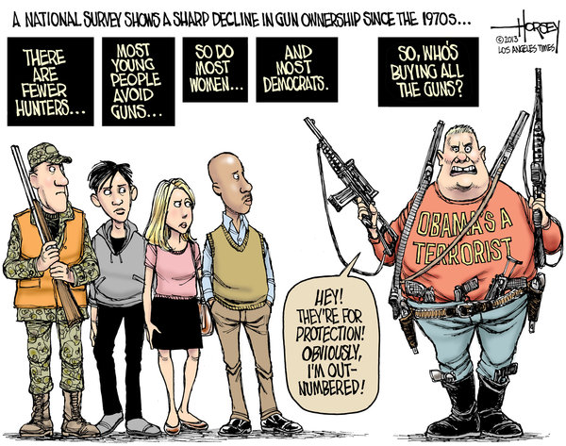
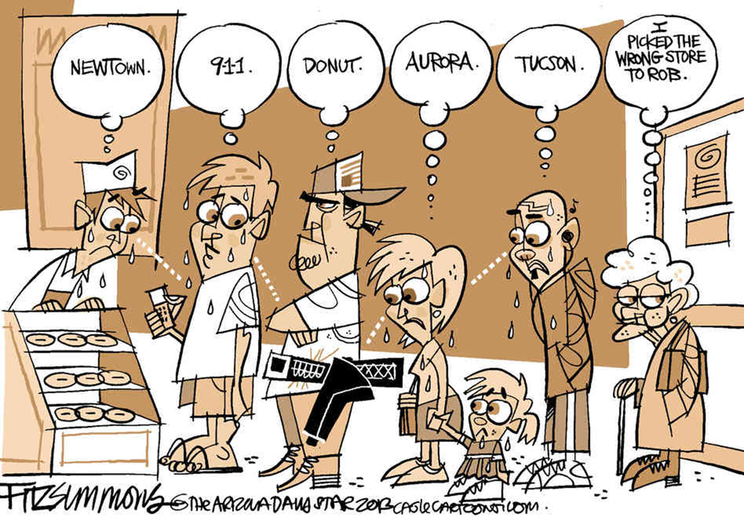
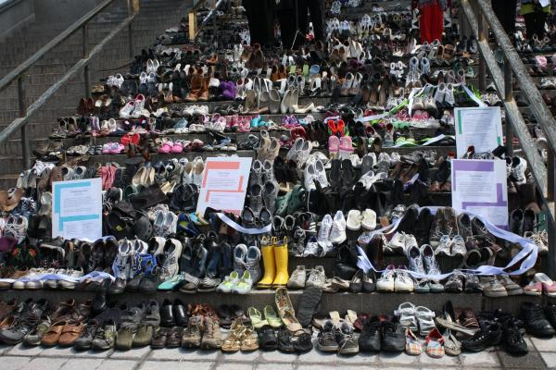
2nd Amendment
Right to Bear Arms
Thousands of People die every year because of guns
Thousands of crimes are prevented because of guns

Slide 8
3rd Amendment
Government cannot force you to shelter soldiers in your home without your permission

Slide 9
4th Amendment
No unreasonable Search and Seizure (search your personal property and take your stuff)
No warrants without probable cause

Slide 10
5th Amendment
No Double Jeopardy
Don’t have to plead against your self
“I plead the fifth”
Due process before conviction
Government cannot take private property without paying you back

Slide 11
6th Amendment
Right to speedy trial
Told of charges against you
Right to a lawyer
Right to trial by an unbiased (or fair) jury
Brian Regan: http://www.youtube.com/watch?v=4vTc88Govj4

Slide 12
7th Amendment
Right to trial by jury when the dispute was more than $20

Slide 13
8th Amendment
No excessive bail
No cruel and unusual punishment
Brian Regan: http://www.youtube.com/watch?v=4vTc88Govj4

Slide 14
9th amendment
Any natural rights written in the Constitution or not written in the Constitution cannot be taken away.

Slide 15
10th Amendment
All rights not listed in the Bill of Rights are retained by the people and states

