Slide 1
Revolution
Forced overthrow of a government or social order

Slide 2
French Revolution
Build up to Revolution

Slide 3
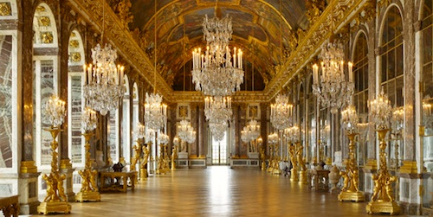
Bad Financial Crisis
Debt
War with England
American Revolution
Excessive spending by the royalty
Needed nobility to help
Nobility wanted to keep money and prove independence
Called for the Estates General

Slide 4
Poverty Problem
Huge gap between rich and poor
Best jobs and offices always given to nobles
Why would King do this?
Third Estate paid all the taxes but had the least means to do it
Extreme Poverty amongst those represented by the Third Estate
“Let them Eat Cake!” Story

Slide 5
Estates General
An assembly that represented the entire French Population through three groups (sort of like congress)
FIRST ESTATE
Roman Catholic Clergy- Paid no Taxes
SECOND ESTATE
Nobles- Paid no taxes
THIRD ESTATE
Peasants and lower class laborers
Had as many delegates as the other two combined
Most people in France would be represented by this estate
Paid all taxes

Slide 6
War Breaks Out
First and Second Estates demand each estate gets one vote
Who would win?
Third estate refuses
Third Estate secedes from Estates General
Created the National Assembly
Storm Bastille (royal jail and arsenal)
This uprising sparked insurrections across France
BEGINNING OF FRENCH REVOLUTION

Slide 7
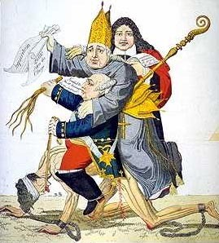
The Causes of the French Revolution
Cartoon and paragraph response

Slide 9
Enlightenment Ideas
Reason and Logic
Natural laws of Science AND Natural laws of man
Separation of Power
Social Contract
Freedom and Liberty

Slide 11
Key Terms for French Revolution
Versailles: King Louis XVI’s extravagant palace outside of Paris
King Louis XVI: King of France, ruled as an absolute Monarch
Robespierre: Extremely radical leader of the French Revolution
National Assembly: First government group created by the Revolutionaries
National Convention: Second government group created by the Revolutionaries
Created a new Constitution for France
The Directory: Last government group created by the Revolutionaries
Jacobins: Extremely radical revolutionaries

Slide 12
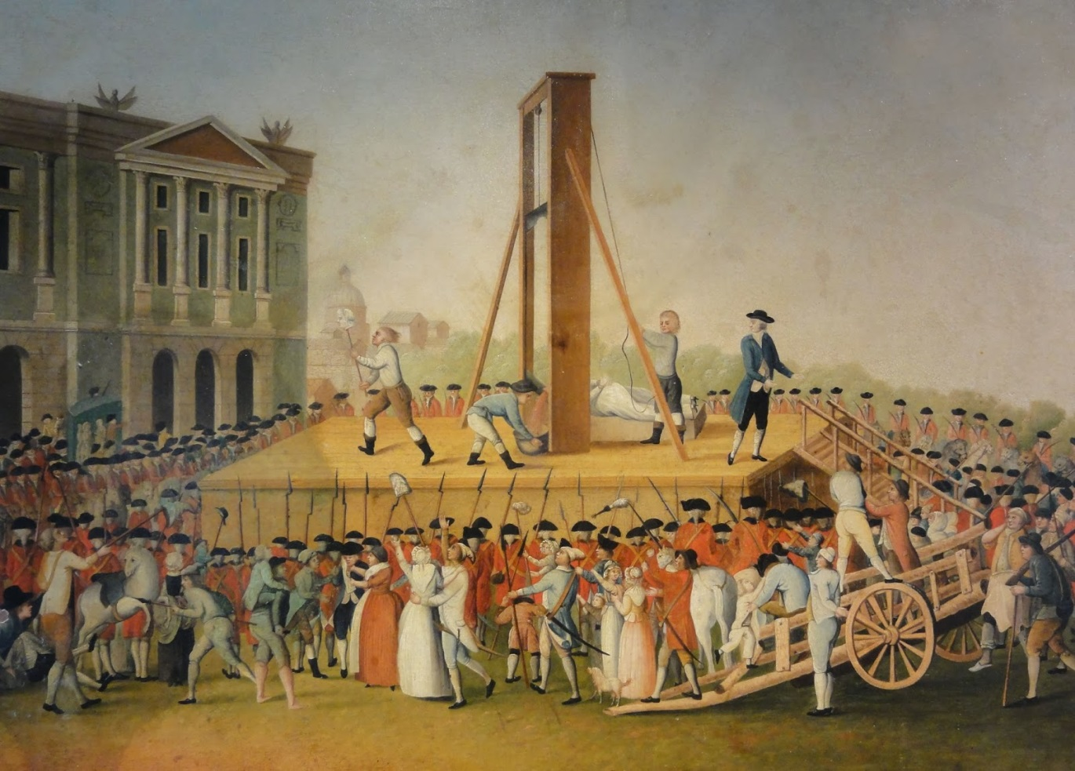
Key Terms from French Revolution

Slide 13
Video
http://www.history.com/topics/french-revolution/videos/the-french-revolution
https://www.youtube.com/watch?v=fk0YI96iBfA
Notes:
YouTube: The French Revolution from the History Channel
Skip 17:00-19:00

