Slide 1
Aztecs
Native American Civilization

Slide 2
Aztecs
Aztec Empire started out as a small group of people called Mexica
Mexica had a reputation for making trouble; kidnapping women, stealing land with already cultivated with crops
Moved around fighting with other people and sometimes only surviving on fly eggs and snakes
Until they settled and established their central city

Slide 3
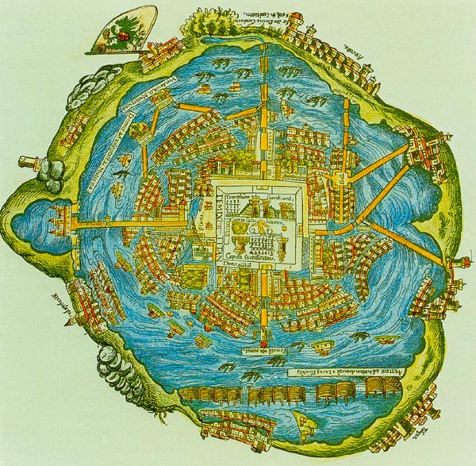
Aztecs
Central city called Tenochtitlan
Island in a marshy region of Lake Texcoco (modern day location of Mexico City)
Use Chinampas as form of agriculture
Dredge fertile soil from bottom of lake to make plots of fertile land
Tapped into water around plots for irrigation

Slide 4
Aztecs
Aztecs had an imperialistic mindset
Once they established Tenochtitlan, they conquered nearby native people to create a powerful empire

Slide 5
Aztec Religion
Gods set the world in motion through sacrifice
Letting their blood flow gave the Earth moisture to bear crops
Aztec Empire honored the gods through sacrifices
Self sacrifice
Human sacrifices
Often sacrifice criminals

Slide 6
Culture of Aztecs
The people whole built the Aztec Empire were called Mexica
Central city was built in the middle of a lake
Dredged up fertile soil from the bottom of the lake to make agricultural plots
Tapped into the waterways around their plots for irrigation
Honored their gods with human sacrifices

