Slide 1
Ancient Greece

Slide 2
Geography of Greece
Greece is a mountainous peninsula with lots of islands
This caused the people to be isolated; they each developed unique city states

Slide 3
City-State or Polis
Definition: A city, that with its surrounding territory, forms an independent state.
Since each city state was isolated from the next they developed unique cultures and governments
There were many city states in Greece, Sparta and Athens are the prominent

Slide 4
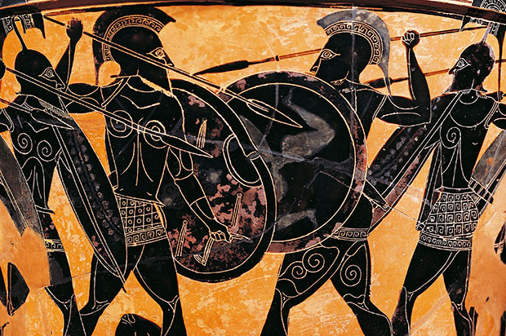
SPARTA
Military State
Sparta means “highly self-disciplined
Males spent childhood learning military discipline
Enrolled in military service at age 20
Lived in barracks until age 30 even if they got married
Spartan women often lived at home by themselves
This gave them more power in the home than most women during that time
Oligarchy: Government controlled by the few
Two Kings who led military campaigns
Ephors: Group of five men who controlled education of youth and conduct of citizens
Discouraged travel; people might encounter ideas that questioned their military state
Spartan citizens were discouraged from studying philosophy, literature or the arts
Only study the art of war

Slide 5
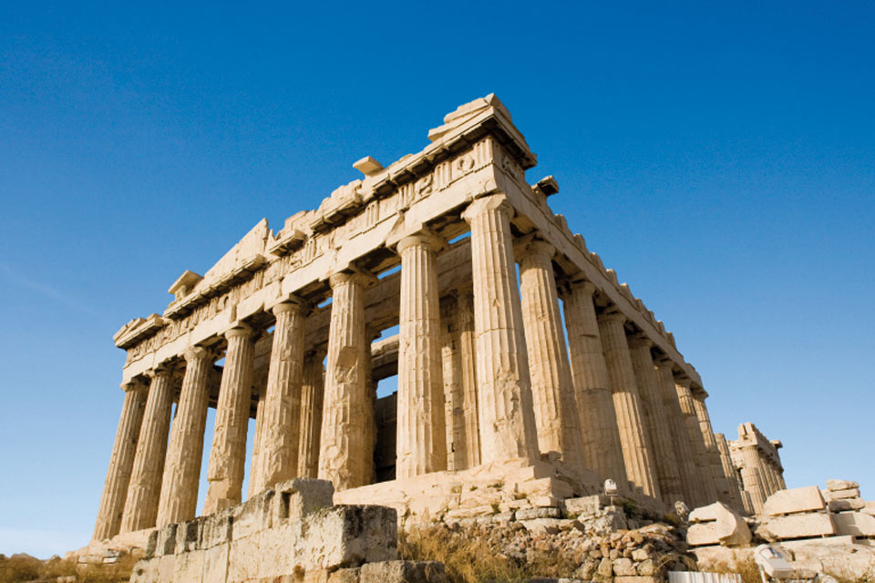
ATHENS
Direct Democracy: the people participate directly in government decision making through mass meetings
Ostracism
To protect against harmful political leaders, people could write the name of a person they considered harmful
If 6,000 members wrote that name, the individual would be banned from the city for 10 years
1/3 of the population of Athens were slaves
Successful agriculture
Women were usually expected to remain at home and out of sight except on festival days
Women always had a male guardian
Promoted art, architecture, literature and philosophy

Slide 6
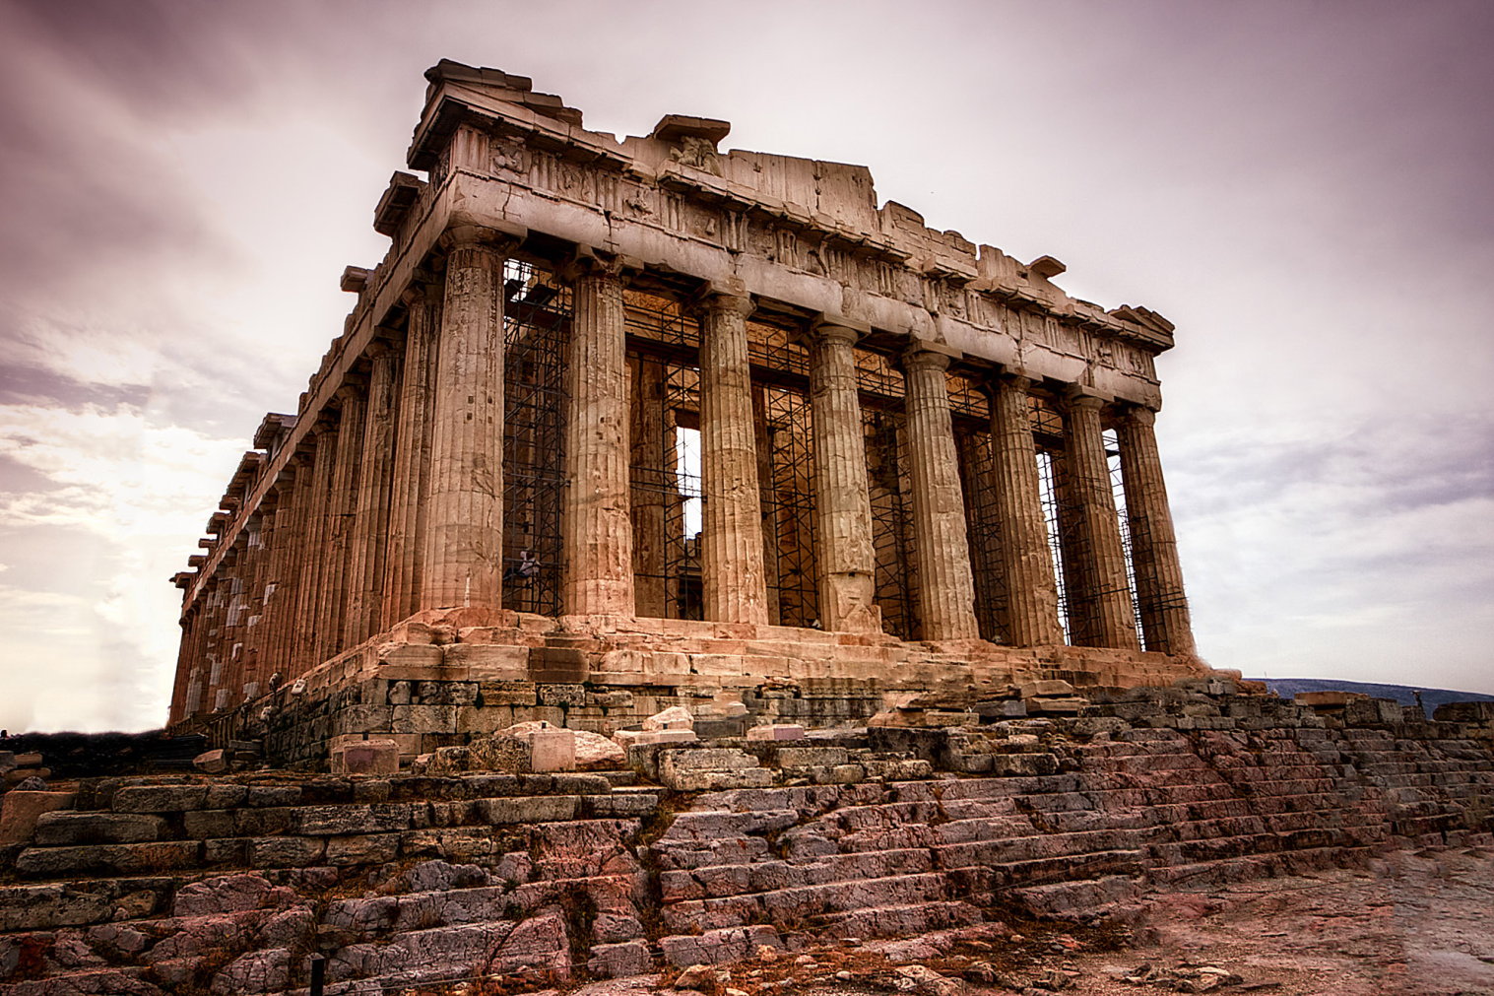
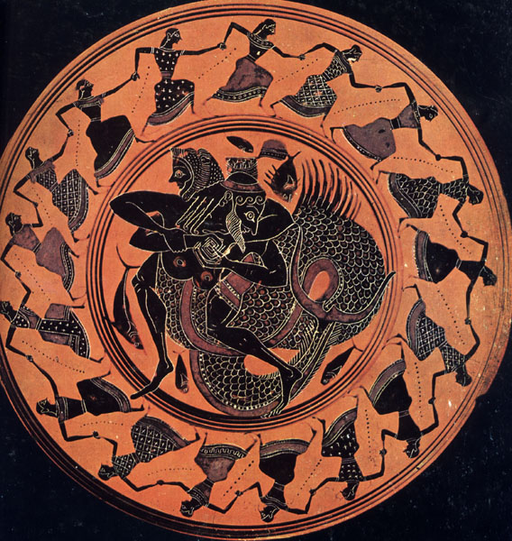
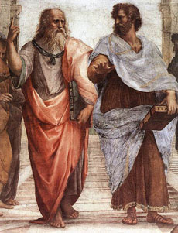
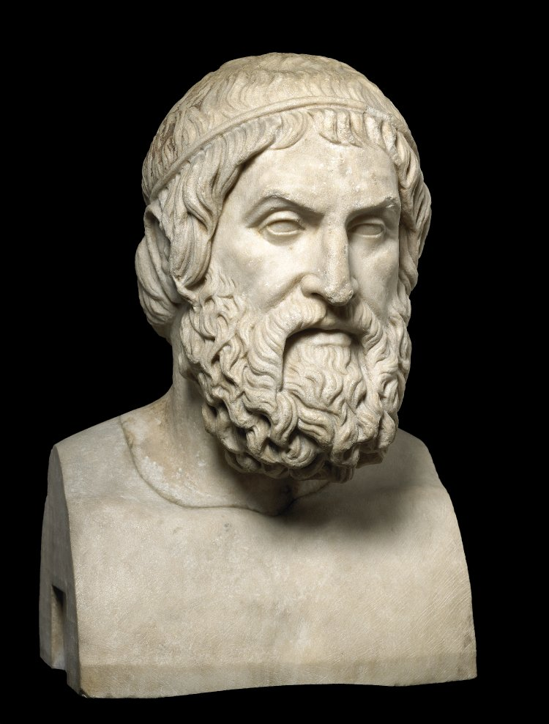
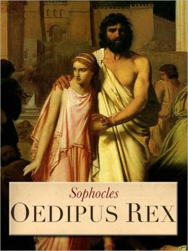
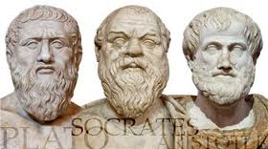
Notes:
Parthenon: Greek temple to the Athena, goddess of Athens; represented the glory of Athens
Greek Philosophers: Plato, Socrates and Aristotle were all educated in Athens; considered the fathers of philosophy
Art: Athens was the center of Greek art
Sophocles: famous Greek playwright wrote tragedy (protagonist has conflict with superior force, protagonist brought to ruin because of the protagonists fatal flaw), Oedipus Rex is the most famous of his plays, Oedipus is told he will kill his father to marry his mother and he does

Slide 7
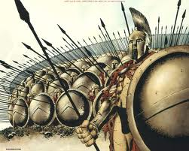
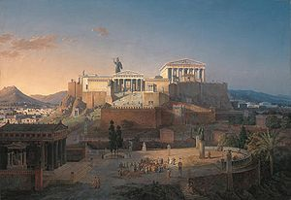
Review of City States
Athens
Sparta
Military State
Oligarchy (rule by the few)
Women=more freedoms than other states
Discouraged from studying philosophy, literature and art
Democracy
Center of Greek culture
Art, architecture, literature, philosophy
Women strictly controlled
Ostracism- exile those who pose a threat to society (10years)
Slavery

Slide 8
Athenian Direct Democracy
Advantages
Disadvantages
People Control their Government
Voice of people is never lost in representatives “claiming” to speak for the people
Government only becomes corrupt if the people become corrupt
Promotes political participation
People don’t complain about government because they are the government
Impractical- Large countries could never hold meetings large enough
People often don’t have time to be informed on politics
They make uninformed decisions which leads to bad laws
Decisions often made by unprepared people
Uneducated, uninformed, biased majorities
Decision making takes too long
In emergencies, countries need someone to decide and act quickly
Direct democracies don’t do this
Is the United States a Direct Democracy?
NO! We only took parts of a true democracy
Notes:
Although the US is not a direct democracy, it does lead to ideas about government by the people. People are very involved in gov. We elect representatives but the people also have power to bring them down or overrule what they say.

Slide 9
Coat of Arms- Represents what is most important to that group/individual
Hogwart’s Coat of Arms
Great Britain’s Coat of Arms

