Slide 1
Age of Exploration
European Explorers

Slide 2
Reasons to Explore
1. GOLD
Europeans wanted Asian goods
Silk, Porcelain, Spices, etc.
The middlemen between Asia and Europe made the prices high
Europeans knew if they could trade directly with Asia, they could make more money

Slide 3
Reasons to Explore
2. God
Europeans were deeply Christian
They believed they needed to spread the word of Jesus Christ to the whole world

Slide 4
Reasons to Explore
3. Glory
Finding new lands and new routes would bring personal glory
Finding new land for their country to conquer or influence brings their country glory

Slide 5
Portuguese Success
At first, the Portuguese were the most successful European explorers
First to create a sea route to Asia

Slide 6
Portuguese Success
Henry the Navigator
Prince Henry gathered the finest mapmakers, sailors, and shipbuilders
He improved navigational instruments (ex. Compass)

Slide 7
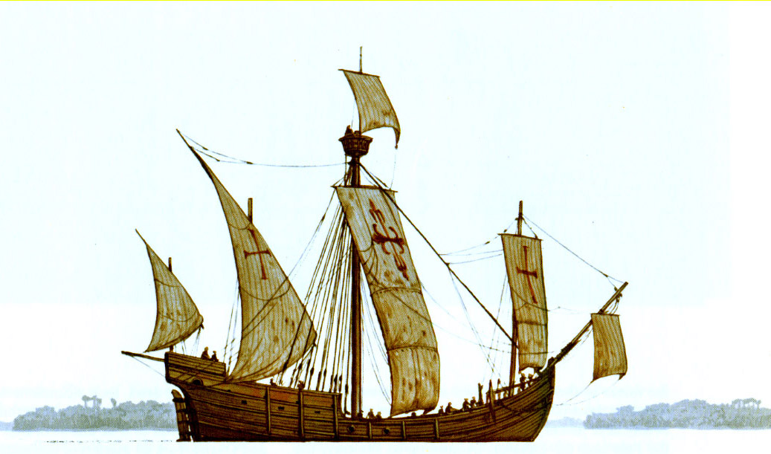
Portuguese Success
Caravel
Henry’s designers developed this ship
It was small, built to move quickly and handle well
Square and triangle sails

Slide 8
