Slide 1
Afghanistan
The influence of the Taliban and
War with America

Slide 2
Afghanistan and the Soviet Union
After WWII the Cold War began
Both the United States (Capitalists) and the Soviet Union (Communists) tried to spread their influence and stop the influence of the other
Soviet Union invaded and occupied Afghanistan for 10 years
Afraid of the spread of communism the United States supported Islamic leaders in Afghanistan who fought against the Soviets
Osama Bin Laden was one of these Islamic leaders
Though Bin Laden and the US were not friends, they were joined together against a common enemy- The Soviets
When the Soviets finally left, these Islamic leaders fought for control of Afghanistan
The Taliban seized control in 1996

Slide 3
The Taliban
Extreme Islamic leaders who controlled Afghanistan from 1996 to 2001
Extremely controlling of their people, deny rights
No education for girls
No make-up
No Kite-flying
No films
Destruction of Different Cultures like Buddhism
Extreme punishment for those who disobeyed
Allowed Al Qaeda to have training camps in Afghanistan
Supported Al Qaeda’s terrorist attacks

Slide 4
9/11/2001
Al Qaeda attacked the Twin Towers
3,000 people killed
Osama Bin Laden was behind this attacks
US believed he was being protected by Afghani leaders
When the Taliban refused to hand over Osama
USA began bombing Afghanistan- October 2001
America the Story of Us Millennium Episode Minute 32:30

Slide 5
War in Afghanistan
Taliban leaders were quickly driven out of the capital city, Kabul
US troops with other allied soldiers occupied Afghanistan
Help build a new stable government
Train Afghan forces
Protect Important Buildings
Act as police
Obama has now withdrawn most US troops from Afghanistan

Slide 6
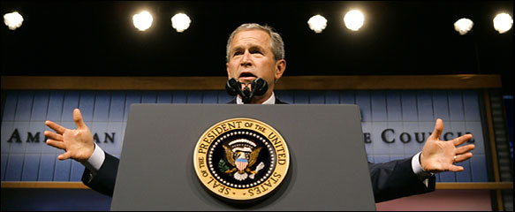
War on Terror
After 9/11 President Bush declared War on Terror
Invade Afghanistan- Get Bin Laden
Invade Iraq- Stop them from developing weapons they could use for terror attacks
These weapons were never found in Iraq
International cooperation to find and destroy terrorist groups

Slide 7
Seal Team VI
Seal Team Six killed Osama Bin Laden in Pakistan, 2011
Al Qaeda has struggled to maintain power since then
ISIS has now risen as the most powerful Terrorist threat to the US
Bin Laden's Compound
Finding Bin Laden
Notes:
two dozen SEALs from the unit stormed the terrorist leader’s compound in Abbottabad, Pakistan, in the early hours of May 2, 2011. According to reports, a firefight broke out, lasting 40 minutes and resulting in the death or capture of 22 people. Bin Laden was fatally shot and then buried at sea after a meticulous identification process. All of the SEALs survived the assault despite a helicopter malfunction that nearly compromised their mission.

Slide 8
Sources
http://www.bbc.co.uk/newsround/15214375

