Slide 1
Geography

Slide 2
What is Geography?
The study of the earth; it’s physical characteristics and it’s human cultures
What is where, why there, why care

Slide 3
5 Themes of Geography
Location
Region
Human Environmental Interaction
Movement
Place

Slide 4
Location
Absolute Location gives an exact location for any place
Ex. Salem Jr. High is located at
40° N, 111° W
598 S 800 W, Salem, UT 84653
Relative Location gives location based on other landmarks
Ex. Salem Jr. High is located near the base of the Wasatch Front and Southwest of Stokes
Tell someone sitting next to you the relative location of Salem Pond

Slide 5
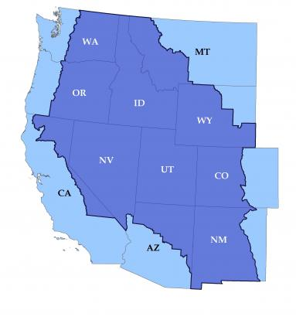
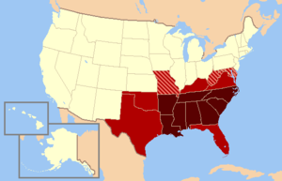
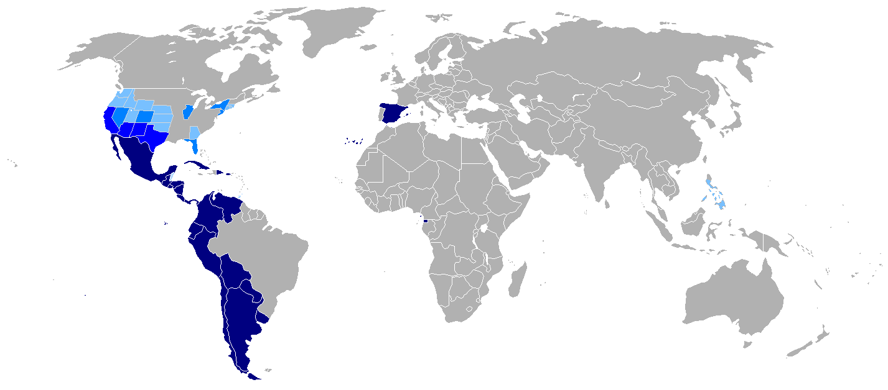
Region
Geographical areas with common characteristics. These characteristics can be physical or cultural.
Example: Northeast, South, Midwest, West
Example: Intermountain West
Example: “Bible Belt”
Example: Spanish Speaking Regions

Slide 6
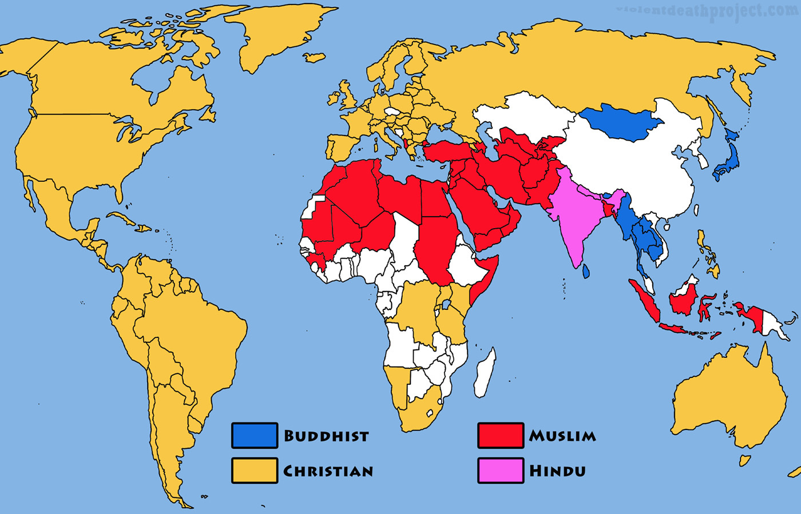
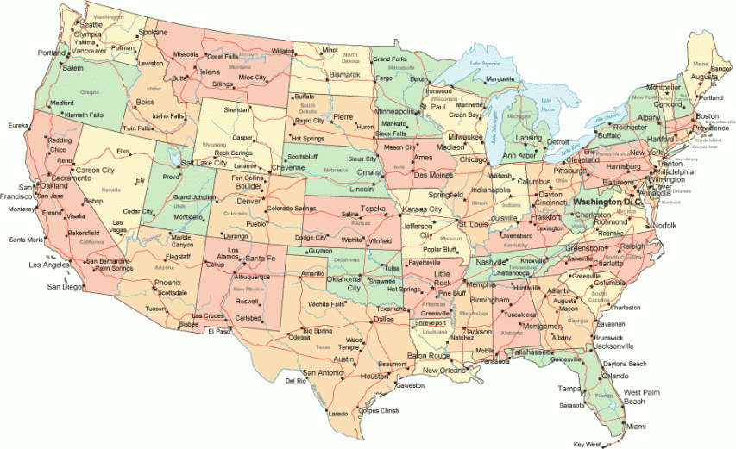
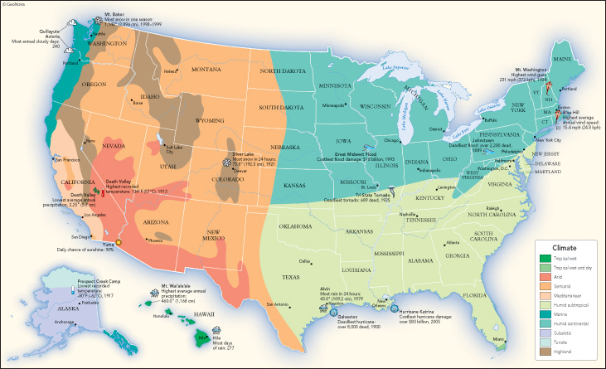
Types of Regions
Political Regions: Areas united by common political boundaries
Ex. Cities, States, Countries
Physical Regions: Areas united by common physical features
Ex. Intermountain West, Desert Region, Coastal Region, Tropical Region
Cultural Regions: Areas united by common cultural characteristics
Ex. Religion, Language, Ethnicity, etc.

Slide 7
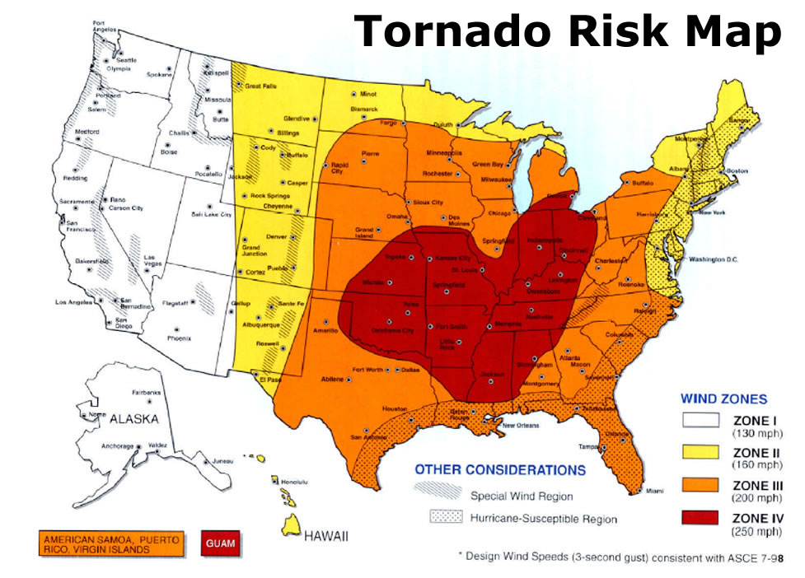
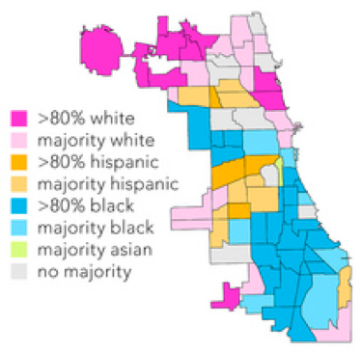
Review Region
Political Regions: Share political Boundaries
Cities, States, Counties, Provinces, Countries, etc
Physical Regions: Common physical features
Climate, vegetation, rainfall, earthquake zones, landforms, etc.
Cultural Regions: Common cultural characteristics
Religion, Language, ethnicity

Slide 8
Human/Environmental Interaction
How people change, use or adapt to their environment.
Humans and the land affect each other

Slide 9
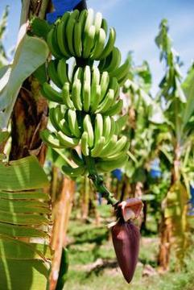
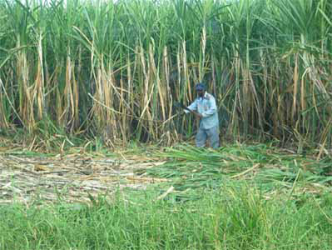
Environment Influences Humans
Notes:
Pineapple field in ghana
Can this produce be made in Utah? No
But we are able to grow some crops because we use irrigation

Slide 10
Humans Influence Environment
https://www.youtube.com/watch?v=fdxHAggOmB4
Pay attention to the growth/decline of the city and lake

Slide 11
Human Environmental Interaction
Humans either change the land, use the land or adapt to the land

Slide 12
Change the Environment
Humans change the environment by building, polluting, growing, etc.
Ex. Building so cities can expand
Ex. Deforestation of rainforest
http://www.youtube.com/watch?v=oBIA0lqfcN4

Slide 13
Use the Environment
Everything we do uses the environment
Traveling, Growing food, Building materials, tools, clothing, etc.

Slide 14
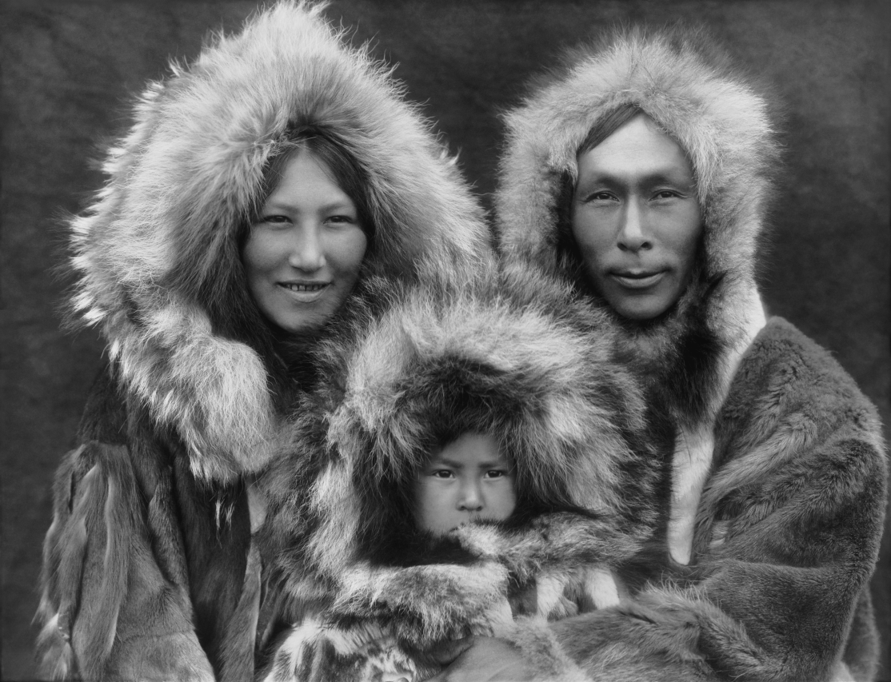
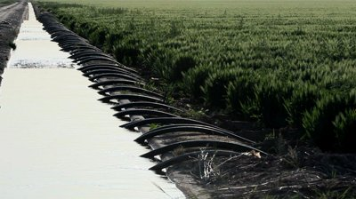
Adapt to the Environment
People must adapt (or adjust) to their environment
How have people in Salem adapted to their environment?
How have people adapted to their environment in Alaska?

Slide 15
Human and Environmental Interaction
Easter Island
Write down how they USED, CHANGED and ADAPTED to their environment

Slide 16
Movement
How people, ideas and cultures move across the world and become connected.
Example: Immigrants moving to the United States
Example: (play songs)

Slide 17
Place
Place is made up of Physical and Cultural Characteristics
These characteristics distinguish places from other places

Slide 18
Place
Look out the window, raise your hand and tell me what you see
These are physical and cultural characteristics that make up the place of Salem, Utah

Slide 19
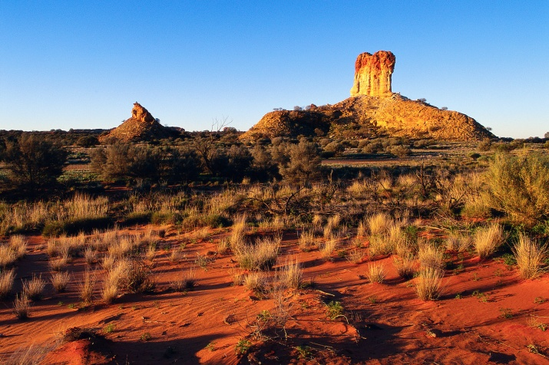
Physical Characteristics
Physical features include mountains, river, vegetation, etc.
Surrounded by a red rock desert, the virgin river flows through, many outcrops of lava, summer temperatures often exceed 100˚

Slide 20
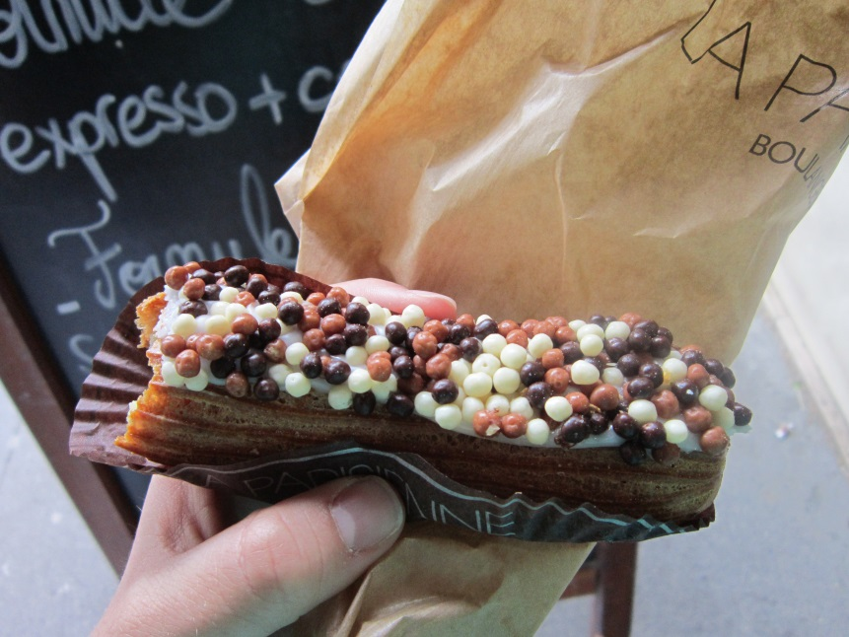
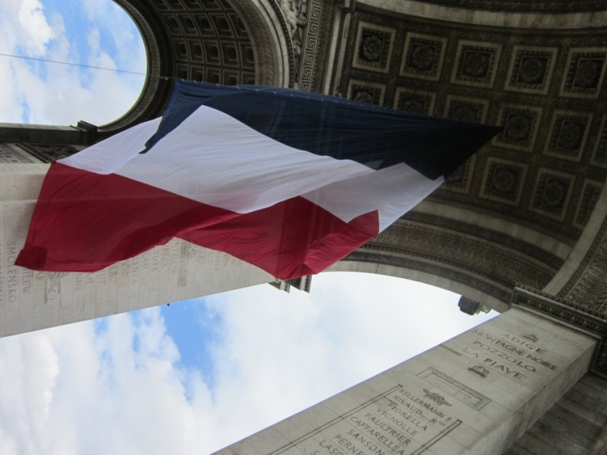
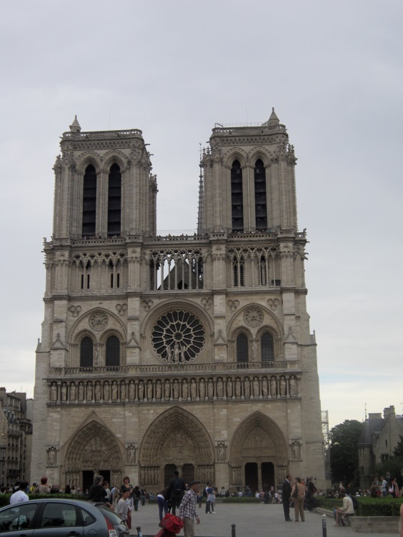
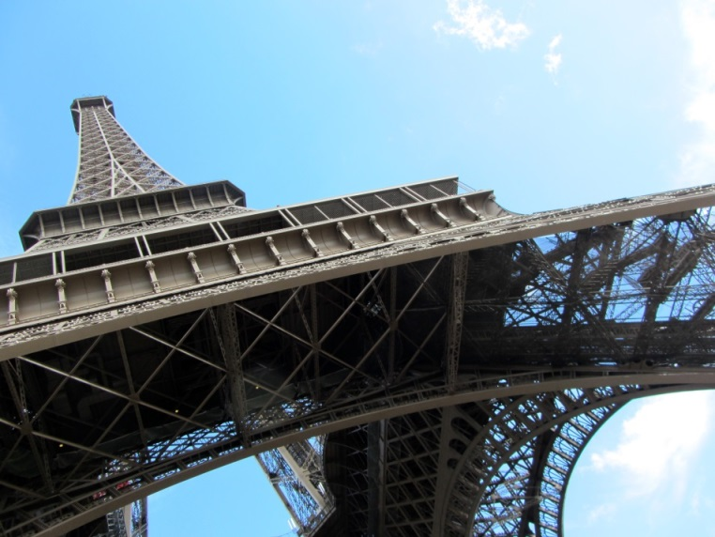
Cultural Characteristics
Cultural characteristics include
Food, Music, Fashion, Religion, Relationships, Literature, Buildings
Can you name this place based on Cultural Characteristics?

Slide 21
https://geoguessr.com/usa

